Slide 1
Conditions for Consistent Global States
The global state of a distributed system is a collection of the local states of the processes and the channels.
Notationally, global state GS is defined as,
  GS = { U_{i}LS_{i} , U_{i,j} SC_{ij}}
A global state GS is a consistent global state iff it satisfies the following two conditions :
C1: send(m_{ij})∈ LS_{i} ⇒ m_{ij} ∈ SC_{ij} ⊕ rec(m_{ij})∈LS_{j}. (⊕ is the Exclusive-OR operator)
C2: send(m_{ij})∉ LS_{i} ⇒ m_{ij} ∉ SC_{ij} Ʌ rec(m_{ij}) ∉ LS_{j}.

Slide 2
Conditions for Consistent Global States
A global state GS is a consistent global state iff it satisfies the following two conditions :
C1: send(m_{ij})∈ LS_{i} ⇒ m_{ij} ∈ SC_{ij} ⊕ rec(m_{ij})∈LS_{j}. (⊕ is the Exclusive-OR operator)
C1 states the law of conservation of messages.
  Every message that is recorded as sent in the local state of some process is either captured in the state of the channel or is captured in the local state of the receiver.
C2: send(m_{ij})∉ LS_{i} ⇒ m_{ij} ∉ SC_{ij} Ʌ rec(m_{ij}) ∉ LS_{j}.
C2 states that for every cause there is an effect.
  If a message is not recorded as sent in the local state of a process P_{i}, then the message cannot be included in the state of the channel C_{ij} or be captured as received by P_{j}.

Slide 3
Data Structures Week 1
Global Snapshots for FIFO channels
– Chandy lamports Algorithm

Slide 4
Chandy-Lamport’s Algorithm
Uses special marker messages.
One process acts as initiator, starts the state collection by following the marker sending rule below.
Marker sending rule for process P:
    P records its state and
    For each outgoing channel C from P on which a marker has not been sent already, P sends a marker along C before any further message is sent on C

Slide 5
Chandy Lamport’s Algorithm contd..
When Q receives a marker along a channel C:
  If Q has not recorded its state then Q records its state and also records the state of C as empty; Q then follows the marker sending rule
  If Q has already recorded its state, it records the state of C as the sequence of messages received along C after Q’s state was recorded and before Q received the marker along C
INDIAN INSTITUTE OF TECHNOLOGY KHARAGPUR
Notes:
Example Lecture 12:
https://www.youtube.com/watch?v=odBAt98e2mk&list=PLUJ7JmcrTifBROWODSG8wgyl20XgBuE-N&index=12
Time 15:58

Slide 6
Chandy Lamport’s Algorithm contd..
  If Q has already recorded its state, it records the state of C as the sequence of messages received along C after Q’s state was recorded and before Q received the marker along C
  Say a marker is received at Pj from say Pi where Pj has already recorded its state. Now there can be no messages sent from Pi to Pj from when Pi records the state to when Pi sends out the markers. Hence this msg received was sent before Pi marked its state and received after Pj marked its state. Thus, this msg belongs to the transit messages in Channel (Pi, Pj)
INDIAN INSTITUTE OF TECHNOLOGY KHARAGPUR

Slide 7
True/False
Markers sent on a channel distinguish messages sent on the channel before the sender recorded its states and the messages sent after the sender recorded its state
The state collected may not be any state that actually happened in reality, rather a state that “could have” happened
INDIAN INSTITUTE OF TECHNOLOGY KHARAGPUR

Slide 8
True/False
Markers sent on a channel distinguish messages sent on the channel before the sender recorded its states and the messages sent after the sender recorded its state -True
The state collected may not be any state that actually happened in reality, rather a state that “could have” happened -True
INDIAN INSTITUTE OF TECHNOLOGY KHARAGPUR

Slide 9
Process having received a marker
Once a process P receives a marker for the first time he records his state. Lets look at what kinds of msgs he can now receive
From the initiator – a msg sent before the marker
From the initiator – the marker msg
Msg from some process that has not received a marker yet
Msg from some process that has received its marker and is sending marker to P
Msg from some process that has received its marker and has already sent a marker to P and is now sending some other msg
INDIAN INSTITUTE OF TECHNOLOGY KHARAGPUR

Slide 10
Process having received a marker
Lets analyse what should be the state of the channel in each case
From the initiator – a msg sent before it sent the marker
The initiator sent this before marking its global state and the msg is reaching after P marked its state. Hence the msg should be a transit msg
From the initiator –the marker
The initiator sent this after marking its global state and the msg is reaching after P marked its state. Hence the msg is not in transit at the global snapshot
Msg from some process K that has not received a marker yet
Msg sent before K marked its snapshot and received after P marked its snapshot so should be a transit msg
Msg from some process that has received its marker and is sending one to P – non transit msg
Msg from some process that has received its marker and has already sent a marker to P and is now sending some other msg – non transit msg
INDIAN INSTITUTE OF TECHNOLOGY KHARAGPUR

Slide 11
Notable Points
Markers sent on a channel distinguish messages sent on the channel before the sender recorded its states and the messages sent after the sender recorded its state
The state collected may not be any state that actually happened in reality, rather a state that “could have” happened
Will it work if not FIFO channels?
Message complexity ?
INDIAN INSTITUTE OF TECHNOLOGY KHARAGPUR

Slide 12
Notable Points
Markers sent on a channel distinguish messages sent on the channel before the sender recorded its states and the messages sent after the sender recorded its state
The state collected may not be any state that actually happened in reality, rather a state that “could have” happened
Message complexity ?O(|E|), where E = no. of links
INDIAN INSTITUTE OF TECHNOLOGY KHARAGPUR

Slide 13
Chandy-Lamport algorithm – FIFO Channels
Will the algorithm work for NON FIFO channels?
Consider a process P who is just about to receive his first markerfrom X. A message sent by X after the marker msg arrives at P first due to non FIFO property. Thus, condition C2 is satisfied where msg not sent is received before snapshot is taken.
Consider a process P which has already marked its state. Now say it is about to receive a marker from process Q. If channel was not FIFO then the msgs sent from Q after marker would reach before marker and get put into the transit messages list for channel CQP. This defies condition C2 where a message not sent lies in transit.

Slide 14
Data Structures Week 1
When should the algorithm terminate?

Slide 15
Termination Condition
The algorithm terminates after each process has received a marker on all of its incoming channels.
All the local snapshots get disseminated to all other processes and all the processes can determine the global state.

Slide 16
Correctness and Complexity
Correctness
Due to FIFO property of channels, it follows that no message sent after the marker on that channel is recorded in the channel state. Thus, condition C2 is satisfied.
When a process p_{j} receives message m_{ij} that precedes the marker on channel C_{ij} , it acts as follows: If process p_{j} has not taken its snapshot yet, then it includes m_{ij} in its recorded snapshot. Otherwise, it records m_{ij} in the state of the channel C_{ij} . Thus, condition C1 is satisfied.
Complexity
The recording part of a single instance of the algorithm requires O(e) messages and O(d) time, where e is the number of edges in the network and d is the diameter of the network.

Slide 17
Chandy-Lamport algorithm – Summary
The Chandy-Lamport algorithm uses a control message, called a marker whose role in a FIFO system is to separate messages in the channels.
After a site has recorded its snapshot, it sends a marker, along all of its outgoing channels before sending out any more messages.
A marker separates the messages in the channel into those to be included in the snapshot from those not to be recorded in the snapshot.
A process must record its snapshot no later than when it receives a marker on any of its incoming channels.

Slide 18
Chandy-Lamport algorithm – FIFO Channels
The algorithm can be initiated by any process by executing the “Marker Sending Rule” by which it records its local state and sends a marker on each outgoing channel.
A process executes the “Marker Receiving Rule” on receiving a marker.
If the process has not yet recorded its local state, it records the state of the channel on which the marker is received as empty and executes the “Marker Sending Rule” to record its local state.

Slide 19
Properties of the recorded global state
The recorded global state may not correspond to any of the global states that occurred during the computation.
This happens because a process can change its state asynchronously before the markers it sent are received by other sites and the other sites record their states.
  But the system could have passed through the recorded global states in some equivalent executions.
  The recorded global state is a valid state in an equivalent execution and if a stable property (i.e., a property that persists) holds in the system before the snapshot algorithm begins, it holds in the recorded global snapshot.
  Therefore, a recorded global state is useful in detecting stable properties.

Slide 20
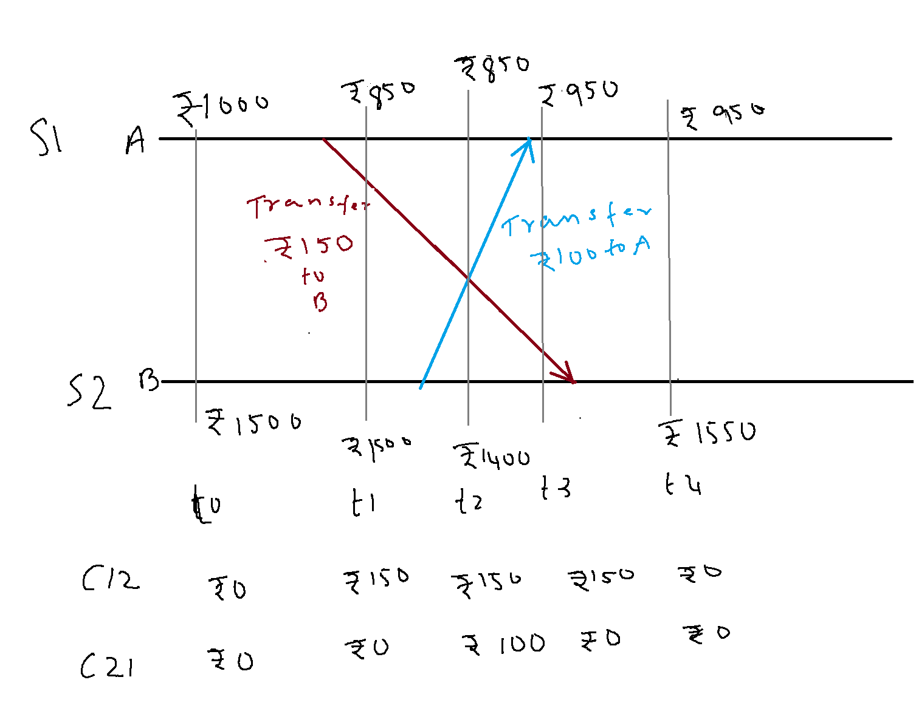
Recorded Global State
Data Structures Week 1
Say S1 initiates right after t1.
This marker received by S2 after t4.
S2 marks its state and sends marker to S1.
Global State= 850(S1)+1550(S2) +
C12=0 (as when it received the marker
S2 had not marked its state) + C21=100 (msg
received btwn S1 marking its state and marker
received from S2)
Total=2500
Say S1 initiates right after t0.
This marker received by S2 after t2.
S2 marks its state and sends marker to S1.
This marker from S2 to S1 can reach only after msg with
transfer of Rs 100 (FIFO order)
Global State= 1000(S1)+1400(S2) +
C12=0 (as when it received the marker
S2 had not marked its state) + C21=100 (msg
received btwn S1 marking its state and marker
received from S2). Total=2500
Neither are true global states

Slide 21
Data Structures Week 1
Multiple processes can initiate the algorithm concurrently- Read page 94 (H.W)

